Slide 1

DIGITAL PORTFOLIO
STUDENT NAME : AGALYA . M
REGISTER NO : 2422k2135
NMID : asbru4w2422k2135
DEPARTMENT : BSC.COMPUTER SCIENCE
COLLEGE : GOVT.ARTS & SCIENCE
COLLEGE-GUDALUR
UNIVERSITY : BHARATHIYAR UNIVERSITY

Slide 2

PROJECT TITTLE
AGALYA’S PORTFOLIO

Slide 3

AGENDA
Problem statement
Project overview
Tools and technologies
Portfolio design and layout
Features and functionality
Results and screenshots
Conclusion
GitHub link

Slide 4
PROBLEM STATEMENT
Problem Statement: Digital Portfolio
In the modern academic and professional world, students need a platform to showcase their skills, projects, achievements, and experiences. Traditional resumes are often limited in content and engagement. A digital portfolio offers a more dynamic, organized, and accessible way to present one's profile.
The goal of this project is to design and develop a personal digital portfolio website that allows a student to display their:
- Academic background
- Technical and soft skills
- Projects and certifications
- Internships or experience
- Contact information and links ( GitHub, LinkedIn, etc. )

Slide 5
Project overview
Project Overview: Digital Portfolio
This project involves creating a personal digital portfolio website for a college student. The portfolio serves as an online resume and showcase of the student’s academic journey, technical skills, and projects. It allows potential employers, teachers, and collaborators to easily access the student’s background, achievements, and contact information.
The website is designed using HTML, CSS, and JavaScript, ensuring it is responsive, user-friendly, and visually appealing across different devices. It includes sections such as About Me, Skills, Projects, Education, and Contact. The project not only highlights the student’s work but also demonstrates their web development abilities.
This digital portfolio acts as a personal brand, helping the student stand out in academic and professional settings.

Slide 6
WHO ARE THE END USER’S ?
1. Students –To showcase their skills, projects, and achievements.
2. Teachers & Mentors –To evaluate a student's progress and work.
3. Employers & Recruiters –To review a candidate’s experience, skills, and project samples.
4. College Admission Officers –To assess a student's profile during applications.
5. Clients (Freelancers) –To view work samples before hiring.
6. Peers or Collaborators –To explore potential partnerships or teamwork.
7. General Public –For inspiration, learning, or networking.

Slide 7
TOOLS AND TECHNIQUES OF HTML
1. Text Editors:
- VS Code (Visual Studio Code)
- Sublime Text
- Notepad++
- Atom
- Brackets
2. Web Browsers (for testing):
- Google Chrome
- Mozilla Firefox
- Microsoft Edge
- Safari
3. Developer Tools:
- Chrome DevTools ( inspect element , console, etc.)
- Firefox Developer Tools
4. Version Control:
- Git
- GitHub(for hosting and sharing code)
5. Live Server (Extension for VS Code):
- Instantly previews HTML in the browser

Slide 8
PORTFOLIO DESIGN AND LAYOUT
The design and layout of a digital portfolio play a crucial role in how effectively it presents information. A well-structured portfolio typically follows a clean, user-friendly layout with clearly defined sections such as a header, about me, skills, projects, education, and contact information. The navigation bar allows users to easily move between these sections. Visually, the portfolio should maintain a consistent color scheme, typography, and spacing to ensure a professional look. Responsive design is essential so the portfolio looks good on all devices, including phones and tablets. Elements like images, icons, and buttons should be used meaningfully without cluttering the page. A balanced layout with proper alignment and white space improves readability and user experience, helping visitors focus on the content without distraction.

Slide 9
FEATURE AND FUNTIONALITY
A digital portfolio offers several key features to effectively showcase an individual’s skills and achievements. It typically includes personal information like name, photo, and contact details for easy communication. The portfolio highlights skills and technical abilities with organized sections or visual indicators. It showcases projects with descriptions, images, and links to live demos or code repositories.
The portfolio is designed to be responsive, ensuring it looks good on desktops, tablets, and smartphones. It often includes navigation menus for smooth browsing between sections. Some portfolios have interactive elements like dark mode toggles, animations, or real-time updates (e.g., displaying current time). Contact forms enable visitors to send messages directly. Additionally, integration with social media and platforms like GitHubor LinkedIn allows users to connect and verify work.
Overall, the functionality ensures the portfolio is easy to update, visually appealing, and accessible to potential employers, educators, or collaborators.

Slide 10
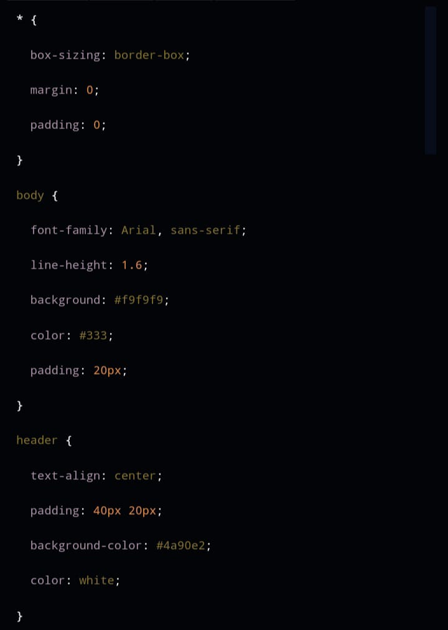
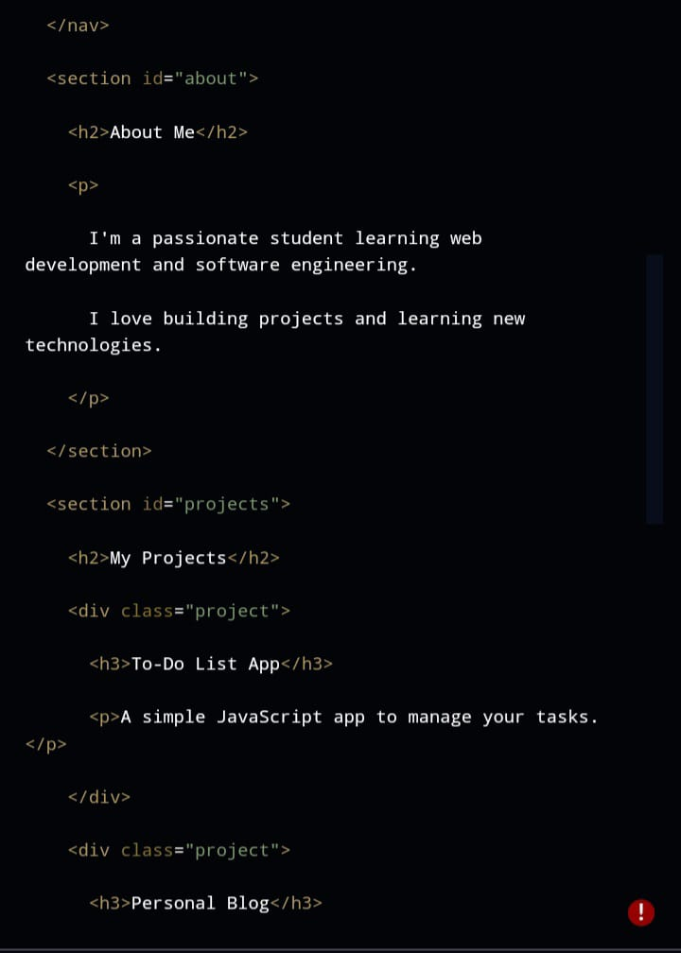
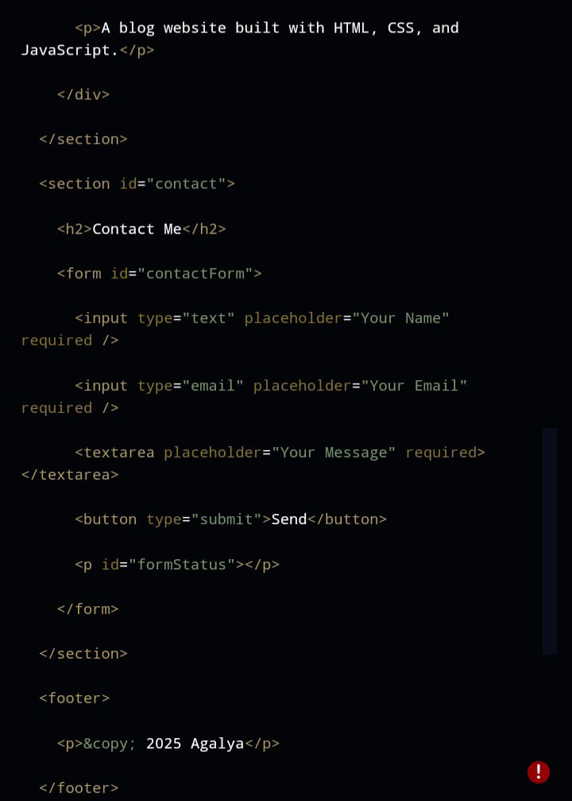
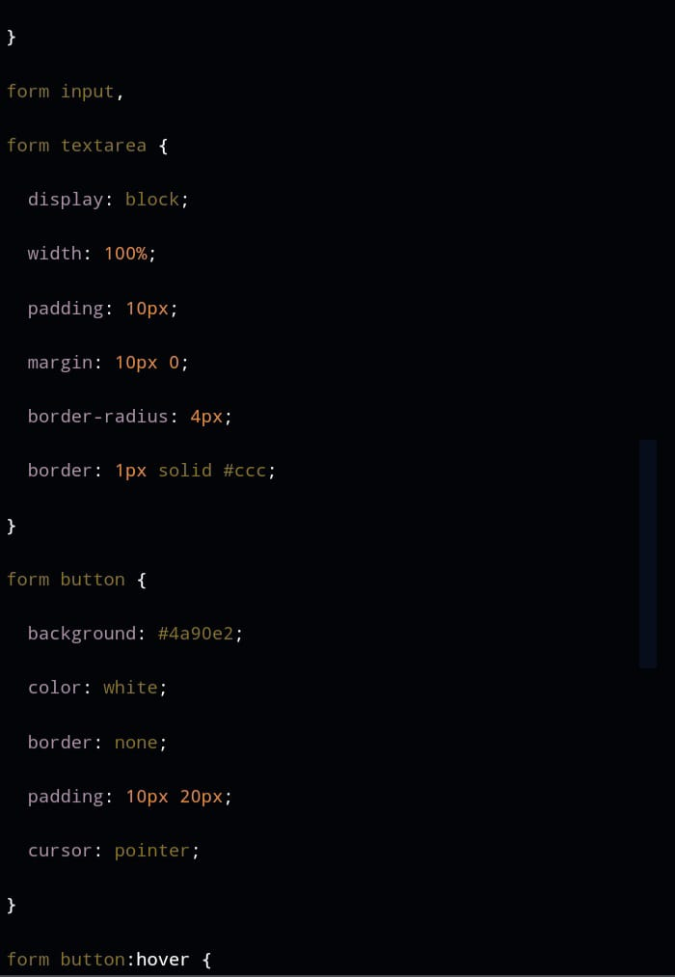
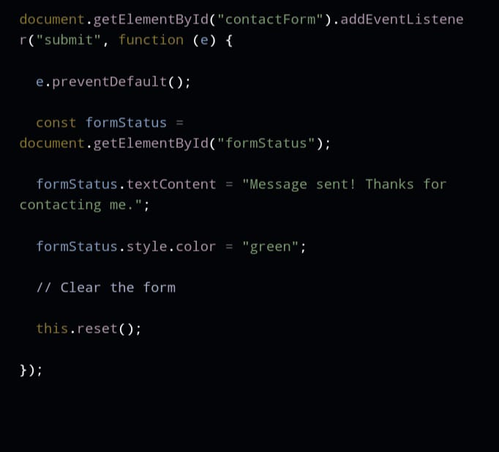
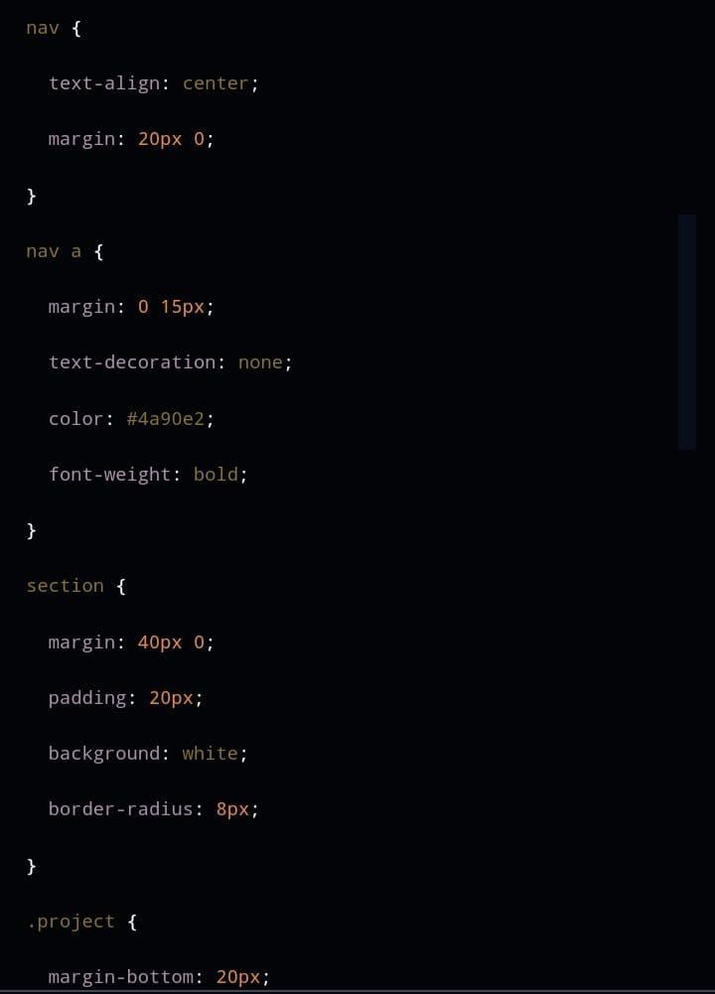
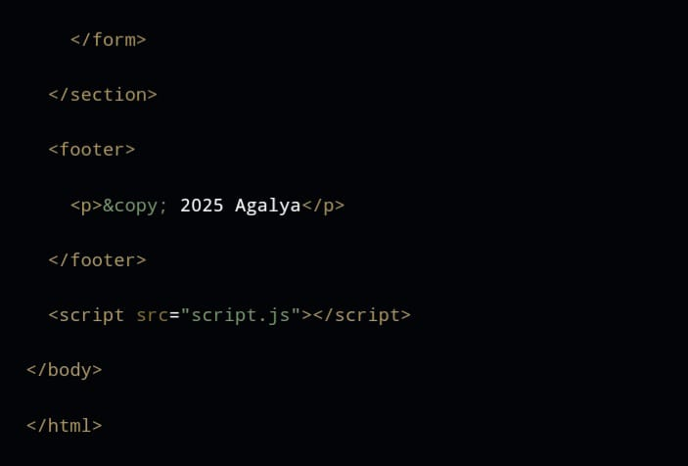
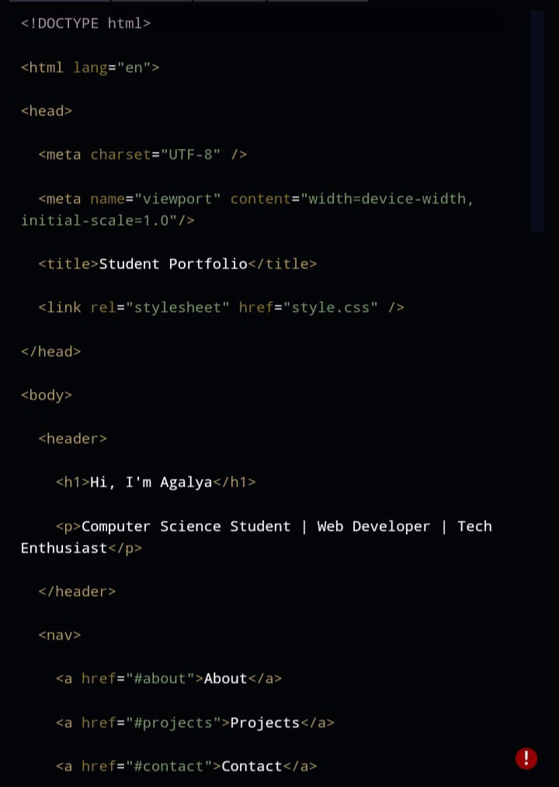
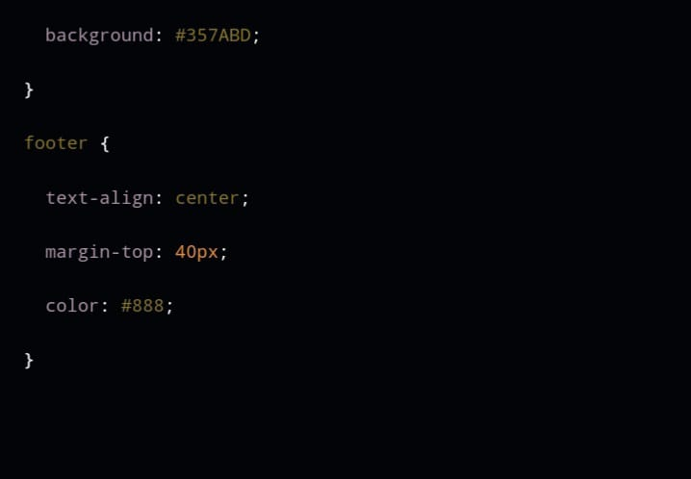
RESULT AND SCREENSHOT
HTML
CSS
JAVA SCRIPT

Slide 11
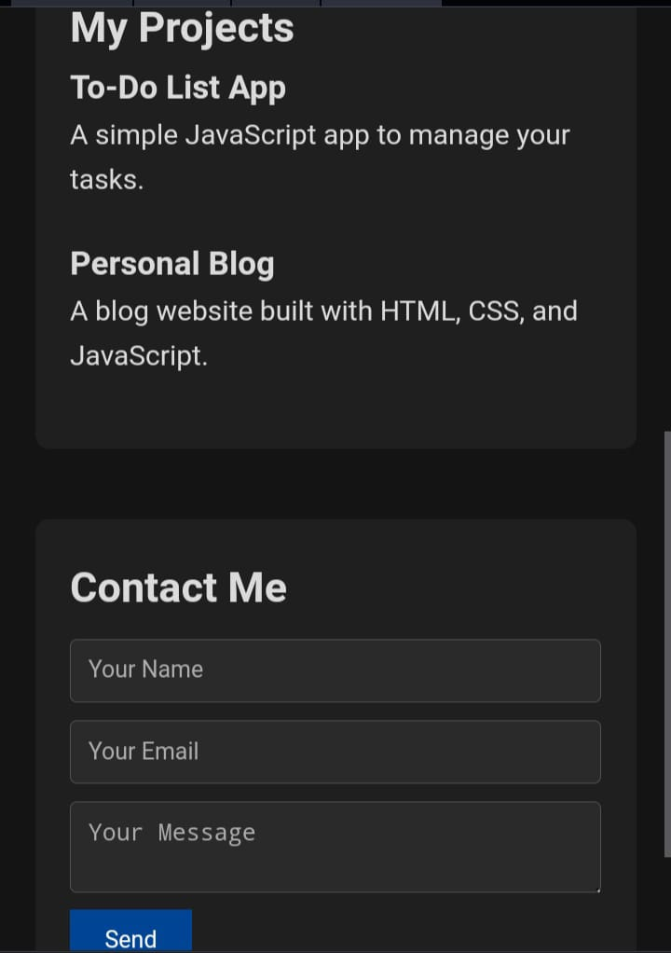
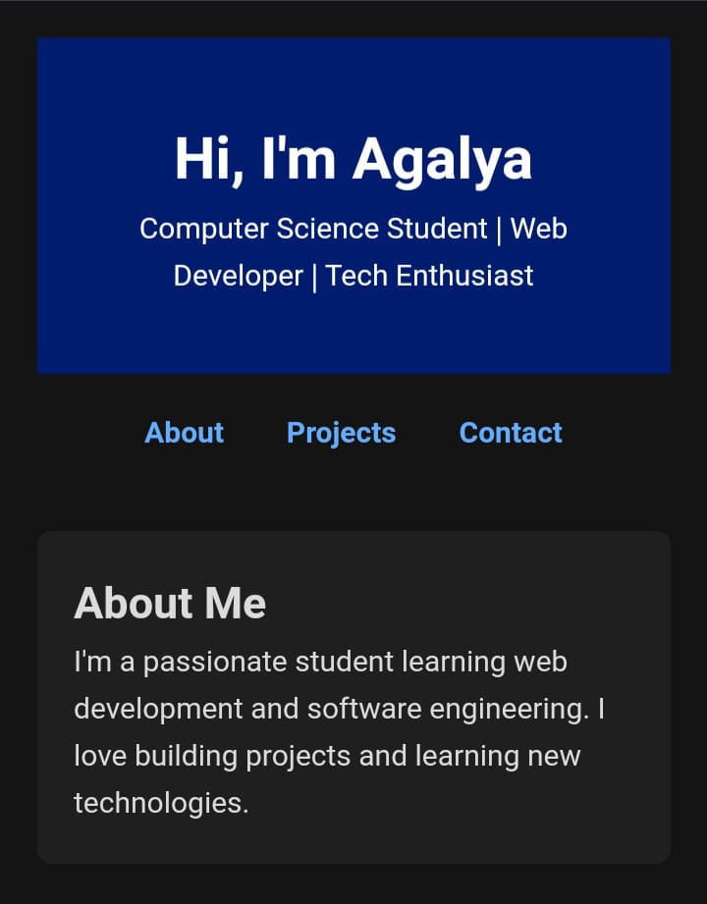
RESULT AND SCREENSHOT

Slide 12
CONCLUSION
Creating a digital portfolio is an effective way for students and professionals to showcase their skills, projects, and achievements in a modern, accessible format. It provides a dynamic platform that goes beyond traditional resumes by offering visual appeal and interactivity. A well-designed portfolio helps individuals stand out to employers, educators, and collaborators by presenting their work clearly and professionally. Additionally, maintaining a digital portfolio encourages continuous learning and self-promotion, which are essential in today’s competitive world. Overall, a digital portfolio is a valuable tool for personal branding and career growth.

